Slide 1
Home & kitchen confident
Ai at your service
Team 9

Slide 2



Save time & money shopping for your home & kitchen on amazon

Slide 3







MEET TEAM 9
Deborah Aina
Sowmya Shetty
Luther Johnson
Cameron Keplinger
Eshumael Manhanzva
Valarie Miller
Saurabh Singh
Teaching Assistant

Slide 4

WHAT IS THE PROBLEM WITH AMAZON?
I just need a small blender that’s less than $20!
Reading all these reviews is giving me a migraine!
I couldn’t find a spaceship popcorn maker!
Just give me the highest rated product!
Takes time to sort through products
Reading all reviews is maddening
Can’t always tell if what you want is available

Slide 5
THE SOLUTION

Slide 6
ZonBot: AI your amazon cart & Needs
Provides top recommended products & review summaries
Gives highest or lowest price of desired products
Enables you to select products in favorite color
Saves you time and $$$ by sorting reviews and products for you

Slide 7

Let’s see it in action
demo

Slide 8
how zonbot came to be
Developed & trained a recommendation engine using 3 Transformers
DistilBERT 98% accuracy for returning ratings
19% accuracy for returning reviews
LLM-Mistral 8x7B
Remembers past conversations
MiniLML6
Cosine Similarity scores of 91% and 84% (highest rated & most durable)
Enabled:
Real-time interactions
Dual model logic
Embeddings + FAISS
Dynamic Model Routing
Combined speed & depth
Use of real-world data
Modular & expandable
Also used PyTorch, Streamlit, RAG & Vector Data Stores

Slide 9
Zonbot flow
User Query
Text Preprocessing & Embedding
Vector Data Store
Top Relevant Reviews
Sentence Transformer (FAISS)
Mistral 8x7B (RAG/FAISS)
Answer Selection & Response Formatting
ZonBot Final Response

Slide 10
results
Save time and money by using ZonBot
Achieved over 80% accuracy for Cosine Similarity scores
Able to interact as a fluid conversation
Achieve memory with our LLM model

Slide 11
next steps
Expand to other product categories
Test translations into other languages
More prompt engineering
Examine how app could be used outside of Amazon

Slide 12
THANK YOU
Team 9

Slide 13
appendix
Link to github:
https://github.com/sowmyarshetty/CapstoneProject-AI-Class
Link to datasets: https://drive.google.com/drive/folders/1Xri5Tjxpjvv1lF1OGG8mcBW1nvIsDoQb
Charts & graphs (visuals on next slides)

Slide 14
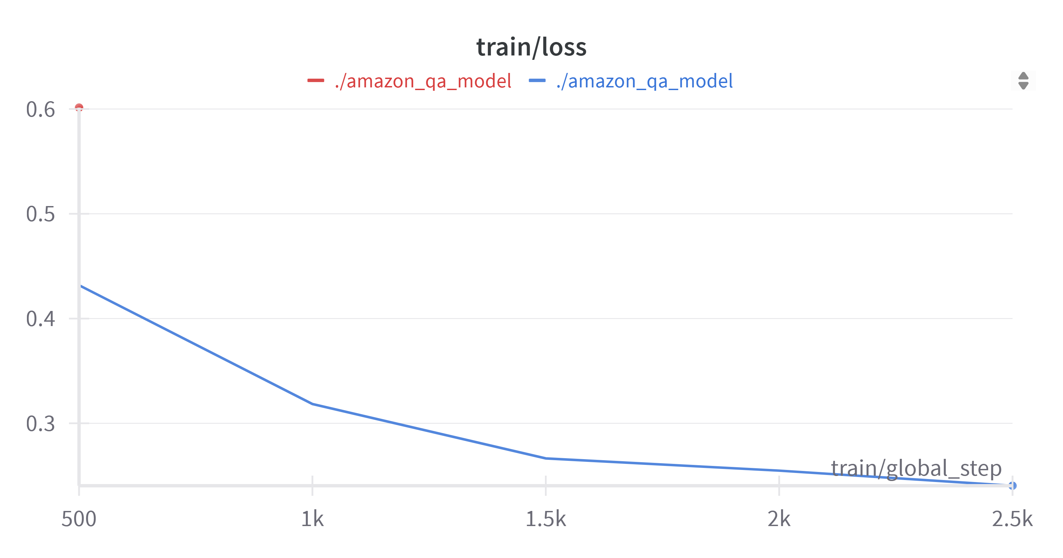
Appendix – model results
Sentence Transformer MiniLML6:
Amazon QA model showing gradual decrease as model is training

Slide 15
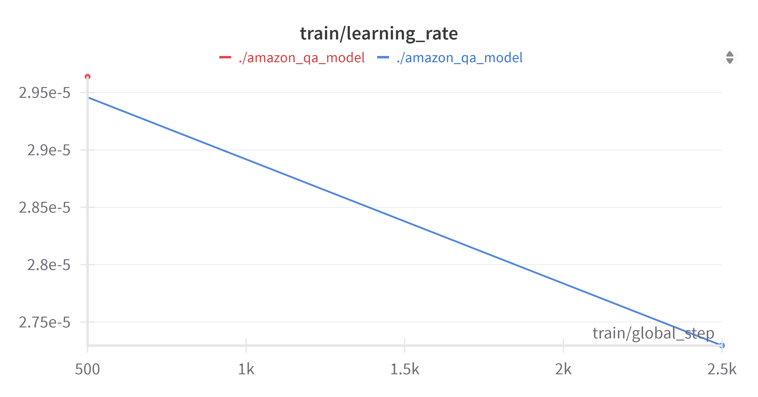
Appendix – model results
Learning rate progression – slowing down toward right destination

Slide 16
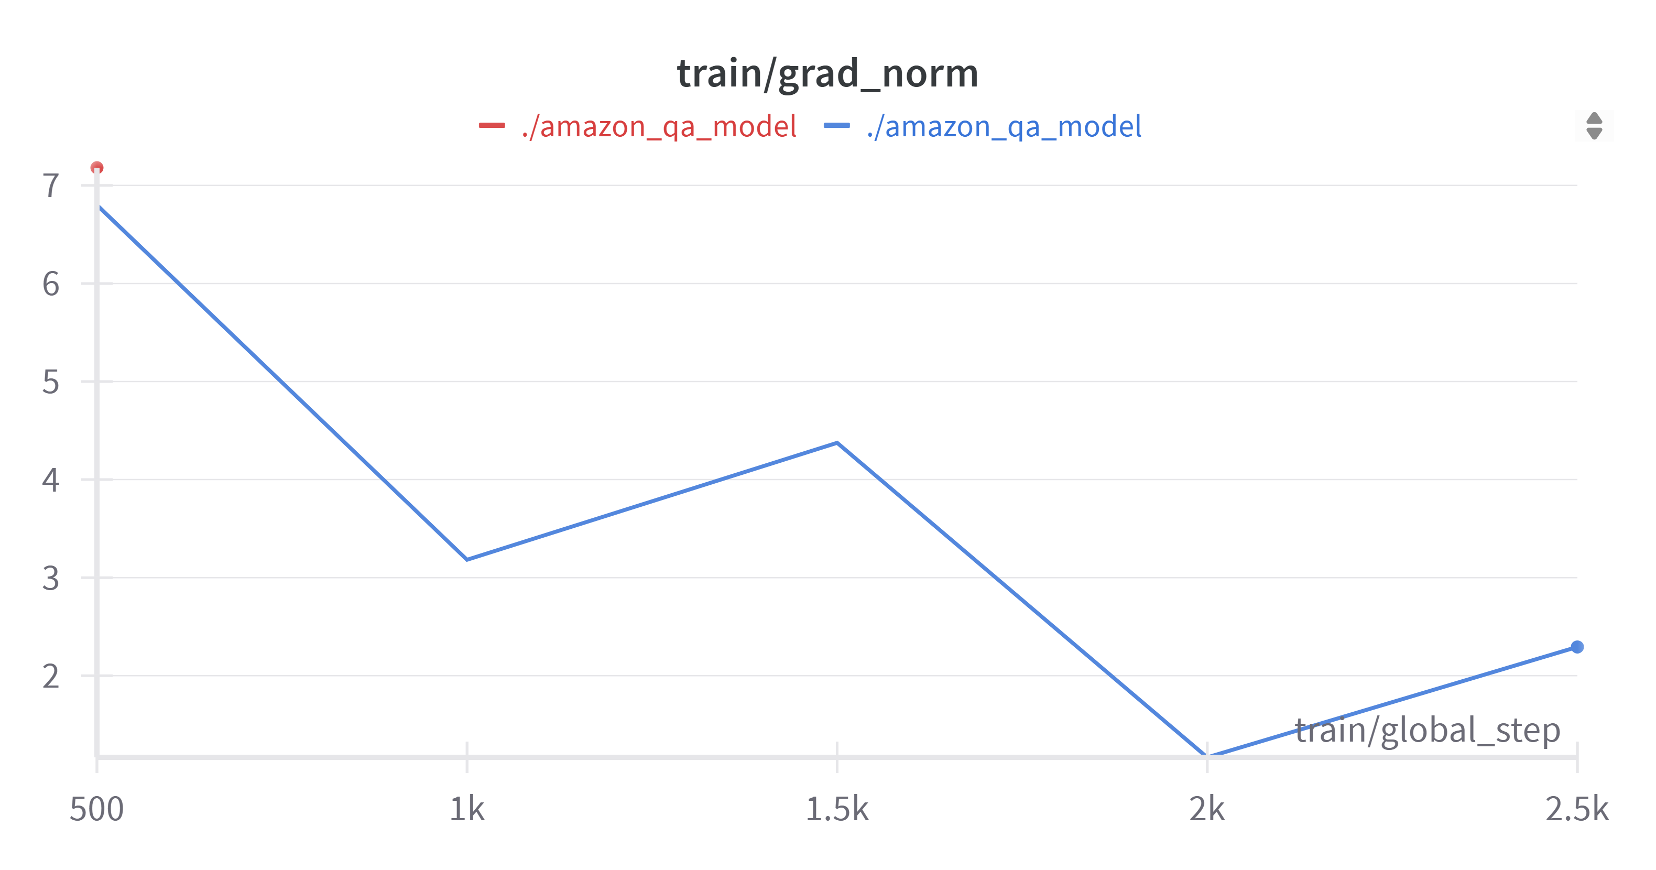
Appendix – model results
Gradient normalization progression

